Slide 1

Object oriented programming
(User-proof your code)
Heather Robinson
Heather.robinson-2@manchester.ac.uk

Slide 2

Approach to new packages
NICE USERS
Read articles to find the best package for the job
Read the instructional PDF
Read the paper
Check the input data thoroughly
Take time to understand the output and check it is right
NAUGHTY USERS
Choose the first package they hear about/that they can get to work
Substitute variable names into the example line of code and hope it works
Violate all the assumptions with the input data
Assume that the output is right because it looks right

Slide 3
User-proofing
Even if you don’t plan to share, packaging makes things easier for your future self
‘Hiding’ as much of the operational code as possible makes it harder for users to break your code
This is only effective if you also outline the assumptions clearly through metadata, prompts and useful error messages
We typically think carefully about processes (functions)
In object oriented programming, we focus on objects (tables, variables, temporary variables) and how the user is going to try and manipulate them(/mess them up!)

Slide 4
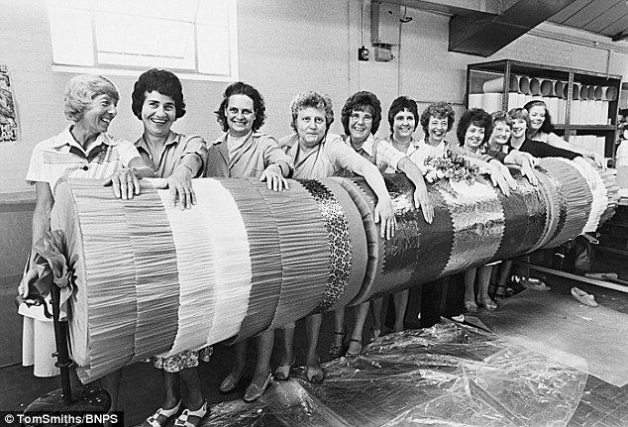
OOP code is long, but robust

Slide 5
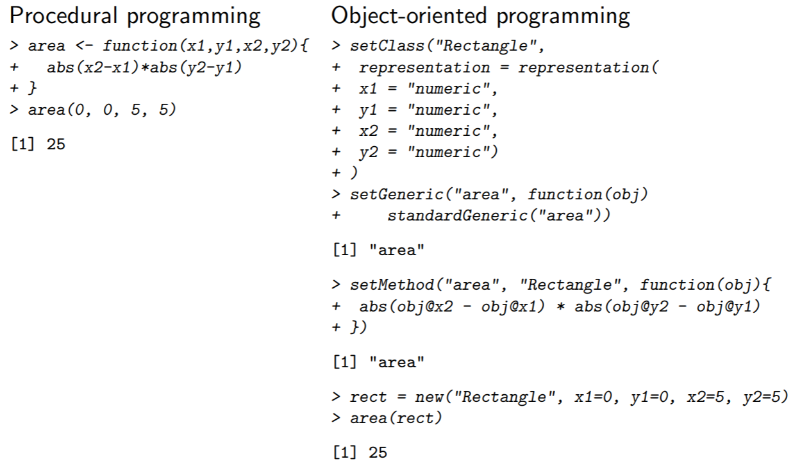
Stojnic & Gatto, 2012

Slide 6
Train R to screen inputs
To prevent our assumptions being violated, create new classes to help R recognise input types, and associate them with new rules
Eg: FASTA files can contain:
DNA: CATGCTAGCC etc…
RNA: CAUGCUAGCC etc…
Peptide sequences: Val Glu Leu Ala etc… OR
ADEJLNB etc…
We can write code to handle various possible formats differently.
There are 3 main frameworks for dealing with different input classes: S3, S4 and RC. (see markdown- RC not covered here)

Slide 7
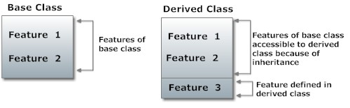
Inheritance
In OOP, objects can simultaneously belong to multiple classes. These are prioritised by R in the order in which they were set.
All features of the base class are inherited (e.g. numeric/character), and new features can be set for the derived class
More at https://www.programiz.com/r-programming/inheritance

Slide 8
Example S4 method:
Stojnic & Gatto, 2012

Slide 9
Extra resources
S4 classes
https://www.r-project.org/conferences/useR-2004/Keynotes/Leisch.pdfObject oriented programming
S3 classes
http://adv-r.had.co.nz/S3.html
Online slides on OOP in R
http://logic.sysbiol.cam.ac.uk/teaching/advancedR/slides.pdf
Upcoming courses with Research IT
13th Feb Introduction to High Performance Computing & using CSF/DPSF
21st Feb Introduction to version control using Git

